Slide 1
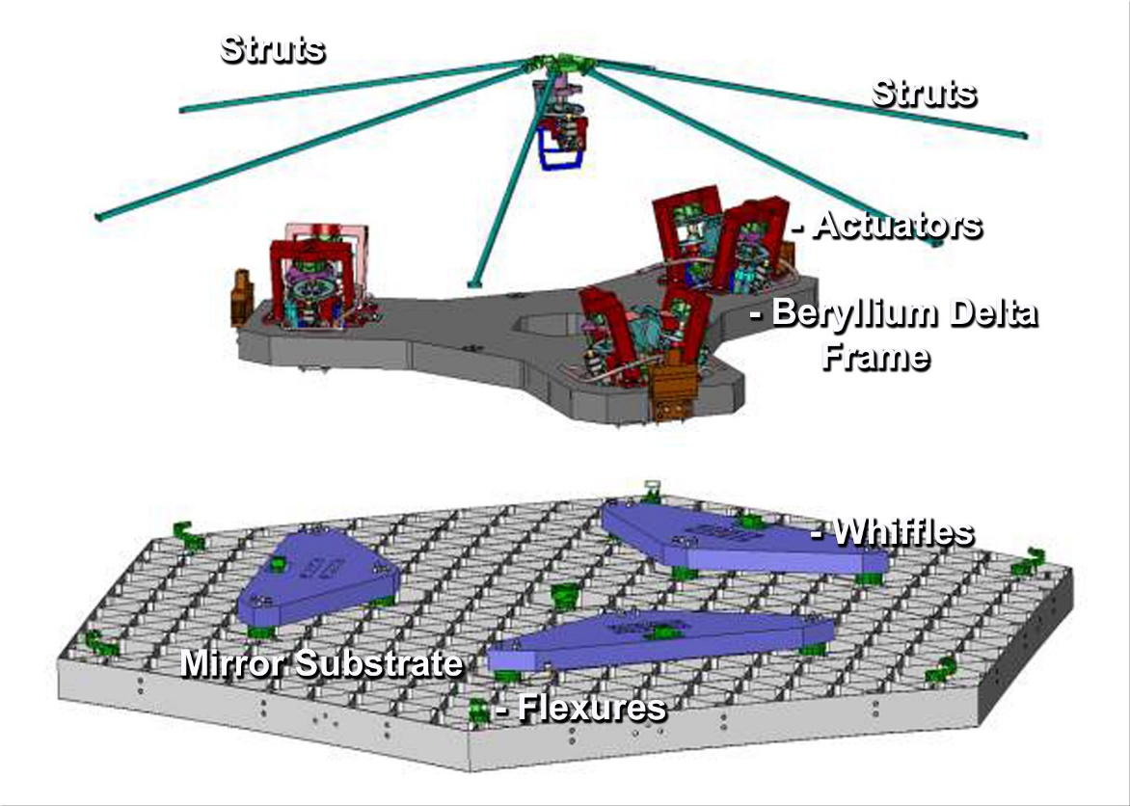


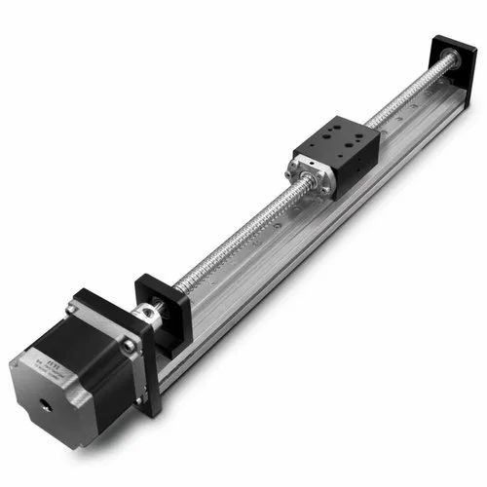
Design and Development of Nano-positioning Actuators
Major Project Review
SAC, ISRO
Shrey Shah
Roll no. -19BME134
Guide: Prof. Mihir Chauhan
Industry – Space Applications centre, Indian Space Research Organization
Industry Guide - Sahil Patel (Sci./Engr. – ‘SD’)

Slide 2
Design and Development of Nano-positioning Actuators
Major Project Review
SAC, ISRO
Shrey Shah (19BME134)
Ph. No – 7016201172
Email id – shrey.shah2303@gmail.com
LinkedIn id - linkedin.com/in/shrey-shah-bb2646213/
Higher Education – MS Robotics @ Umich, Ann Arbor
GRE score – 321/340
TOEFL – 105/120
Admits – 9
Rejects - 2

Slide 3
Outline of Presentation
Introduction
Structural Overview
Integration & Testing of Single Actuator
Addressing discrepancies
Multi Actuator Integration and Testing
Bipod Integration and Testing
Stewart Platform (Hexapod Testing)
3

Slide 4
Introduction

Slide 5
Introduction to EHD
Abstract
An extremely precise positioning mechanism is to be developed for optical positioning of mirrors of a space telescope. As there is little much room in the launch vehicle, segmented mirrors are employed to fit huge mirrors within.
The six actuators for the six degrees of freedom of these segmented mirrors are positioned behind each individual segment to allow for both fine and coarse placement.
For very high precision, these actuators need to be developed with all positioned in such a way that the combined assembly comes as close as possible to the mirror if it was whole.
5
Under the Major Research Project Regulation
Major Research Project 2020
Major Project Review
Institute of Technology, Nirma University
Concept visualization
Institute of Technology, Nirma University

Slide 6
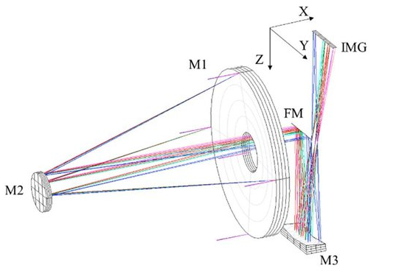
Introduction to the project
Introduction to EHD
The primary mirrors first sense/reflect the light rays from far-off stars, planets, and galaxies.
These rays need to be then focused on the precise location of the secondary mirror, for which appropriate placement of each mirror is crucial.
The entire telescope is needed to be divided in several sections so when the primary mirrors assemble themselves, their position needs to be so precise that when combined, it forms a big mirror.
6
Under the Major Research Project Regulation
Major Research Project 2020
Major Project Review
Institute of Technology, Nirma University
Method
Institute of Technology, Nirma University

Slide 7
Literature review
Property needed | Requirement
Coarse Resolution | < 1 µm
Coarse range | 10 mm
Fine Resolution | < 15 nm
Fine range | < 20 µm and > 10µm
Weight | < 400 gm
Working Temperature | 30 K
Total Height | <150 mm
Available actuators –
Hydraulic
Pneumatic
Electrical
Magnetic
Mechanical
Piezoelectric
Requirements –
Accurately position the actuator for them to reflect the light to the secondary mirror
Fulfil the load criteria during no gravity and 5G.
Type | Resolution | Range
Hydraulic | Sub micrometre | High (upto several meters)
Pneumatic | Sub micrometre | Medium (upto several cms)
Electric | Sub millimetre | High (upto several meters)
Magnetic | Sub millimetre | Low (upto Several mms)
Mechanical | Sub micrometre | High (upto several meters)
Piezoelectric | Sub micrometre | Low (upto several mms)
7
Under the Major Research Project Regulation
Major Research Project 2020
Major Project Review
Institute of Technology, Nirma University, India
Review of requirements
Institute of Technology, Nirma University

Slide 8
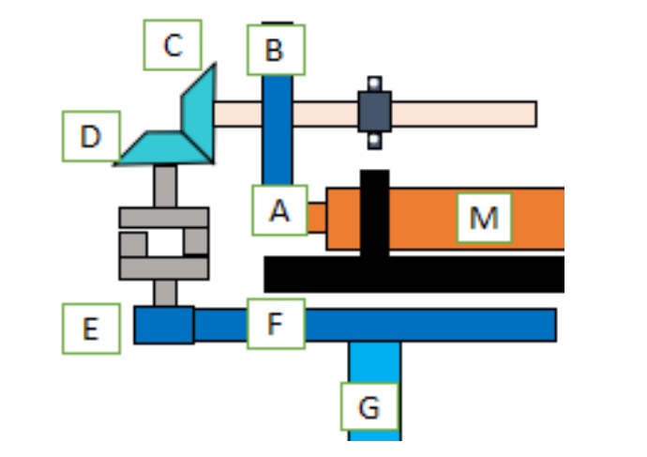
Mechanism and components
Introduction to EHD
Motor
Gearhead (first reduction)
Spur gears
Bevel gears
Eccentric camshaft
Bearings
Main actuator support structure
Motion Reduction Structure
Coarse Drive housing
Coarse drive shafts
Ballscrew
Ballscrew support
Main outer support
Shims
Torsional stabilizer
Sensors for coarse and fine sensing
Disk brake
Raspberry pi
Motor driver (controller)
Gear pairs (for transmission) | Gear type | Transmission | Loses
A - B | Spur to spur | Yes | Yes
B - C | Spur to bevel | No | No
C - D | Bevel to bevel | yes | Yes
D - E | Bevel to Spur (engaged) | No | Yes
E - F | Spur to Spur | Yes | Yes
M = Stepper Motor
A = Spur gear on gearhead output shaft
B = Spur gear on eccentric shaft
C = Bevel gear on eccentric shaft
D = Bevel gear on coarse drive shaft
E = Spur gear on coarse drive shaft
F = Spur gear on ball screw shaft
G = Ball screw shaft
Sub-Assemblies -
Gear motor Assembly
Coarse Drive Coupling
Ball screw Coupling
Torsional Stabilizer
Disk Brake
A – 6 mm
B – 18 mm
C – 6 mm
D – 6 mm
E – 6 mm
F – 30 mm
8
Under the Major Research Project Regulation
Major Research Project 2020
Major Project Review
Institute of Technology, Nirma University
Design
Institute of Technology, Nirma University

Slide 9
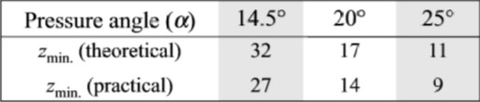
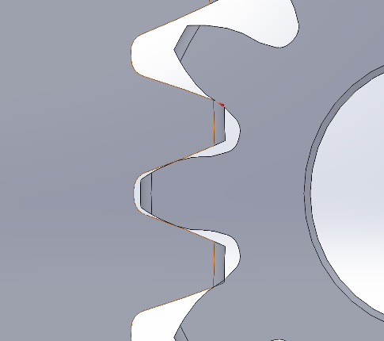
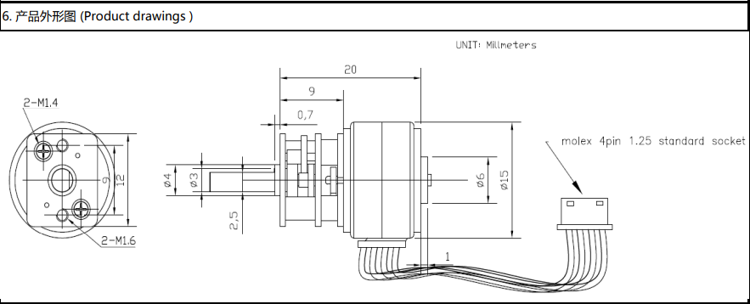
Introduction to EHD
Gear and Motor Selection
Gear Specifications
Motor requirements
Gear notation | PCD | Module | Teeth
A | 6 | 0.4 | 15
B | 18 | 0.4 | 45
C | 6 | 0.4 | 15
D | 6 | 0.4 | 15
E | 6 | 0.4 | 15
F | 30 | 0.4 | 30
Criteria | Requirements
Length | < 45 mm
Diameter | < 20 mm
Torque | > 60 mNm
Degree per step | < 20°
Complementary gearhead | Yes
Gearhead reduction ratio | > 80
Mass | < 20 g
Backlash | < 3°
Things bit motor
Interference
9
Computational Fluid Dynamics: Part-II
SVNIT, Surat
Major Project Review
Institute of Technology, Nirma University
Design and Selection
Institute of Technology, Nirma University

Slide 10
Gear pass calculations
Introduction to EHD
First pass
Gear pair - A and B
Input torque = 0.08 Nm
Radius of A = 6 mm
Radius of B = 18 mm
Efficiency = 0.95
Reduction ratio = 3
Force = 13.33 N
Force to B = 12.66 N
Torque to B = 0.228 Nm
Second Pass
Gear pair = C and D
Input torque = 0.228 Nm
Radius of C = 6 mm
Radius of D = 6 mm
Efficiency = 0.95
Reduction ratio = 1
Force = 38 N
Force to D = 36.1 N
Torque to D = 0.216 Nm
Second pass
First pass
Third Pass
Gear pair = E and F
Input torque = 0.216 Nm
Radius of E = 6 mm
Radius of F = 30 mm
Efficiency = 0.95
Reduction ratio = 5
Force = 36.1 N
Force to F = 34.295 N
Torque to F = 1.028 Nm
Fourth Pass
Gear pair = F and G
(working as worm gear)
Input torque = 1.028 Nm
Radius of G = 2 mm
Efficiency = 0.95
Reduction ratio = nil
Force on G = 514.6 N
Torque on G = 1.028 Nm
Third Pass
Fourth Pass
10
Computational Fluid Dynamics: Part-II
SVNIT, Surat
Major Project Review
Institute of Technology, Nirma University
Gear Design
Institute of Technology, Nirma University

Slide 11
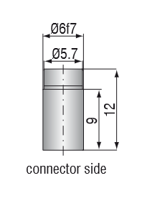
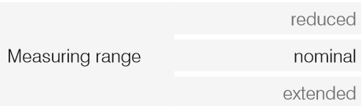
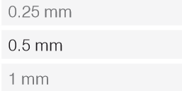
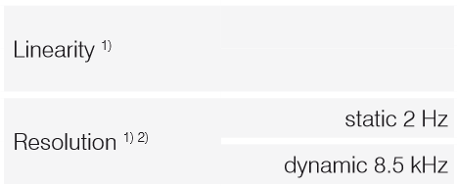
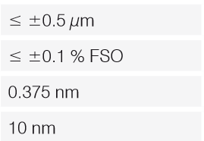
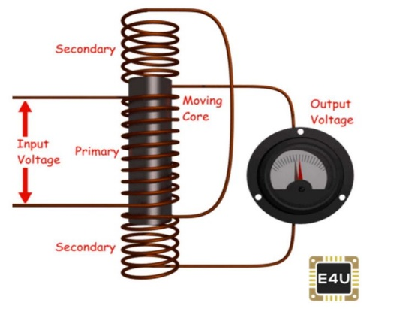
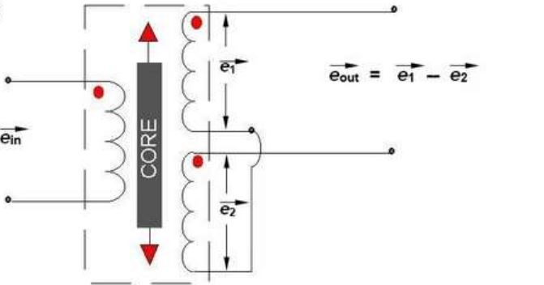
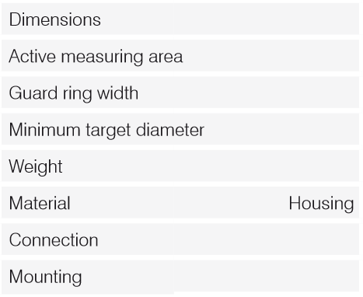
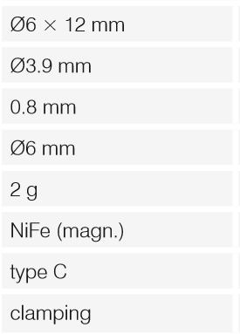
Sensor Selection
Introduction to EHD
Available Sensors -
Inductive Sensors
Capacitive Sensors
Ultrasonic Sensors.
Infrared sensors
Photoelectric Sensors
Sensors used –
LVDT
Capacitive Probe
Sensor | Range | Resolution | Repeatability | Frequency Response
Inductive | 0.5 – 60 mm | 0.5 - 2 µm | < ±1 µm | 5 - 100 kHz
Capacitive | 0.1 – 20 mm | 0.375 - 60 nm | < ± 0.1 nm | 2 -8.5 kHz
Ultrasonic | 0.3 – 450 cm | 0.1 - 5 mm | < ± 1 mm | 50 kHz
Infrared | 2 – 14 µm (spectrum) | 0.5 – 3 mm | < 2 mm | -
Photoelectric | < 1 - 60 mm | 0.05 – 1 mm | < 0.05 mm | -
LVDT working
11
Computational Fluid Dynamics: Part-II
SVNIT, Surat
Major Project Review
Institute of Technology, Nirma University
Electronics
Institute of Technology, Nirma University

Slide 12
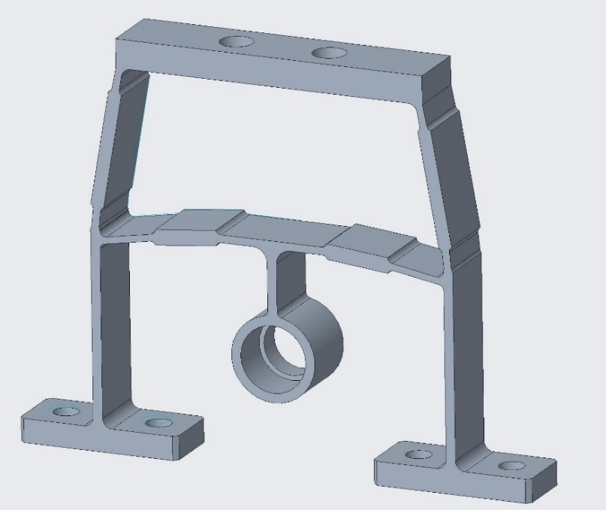
Motion Reduction structure Modelling
Introduction to EHD
Motion Reduction Structure or MRS is a partly flexible element which reduces the motion provided at one end of it when transferring to the other end. As mentioned above, it is one of the most crucial elements of the Actuator. Governing the fine stage motion.
The range and resolution will be decided by this element along with the eccentricity of the eccentric shaft. A snippet of the fine stage flexure is given below.
Final Design of FSF
12
Under the Major Research Project Regulation
Major Research Project 2020
Major Project Review
Institute of Technology, Nirma University
MRS modelling
Institute of Technology, Nirma University

Slide 13
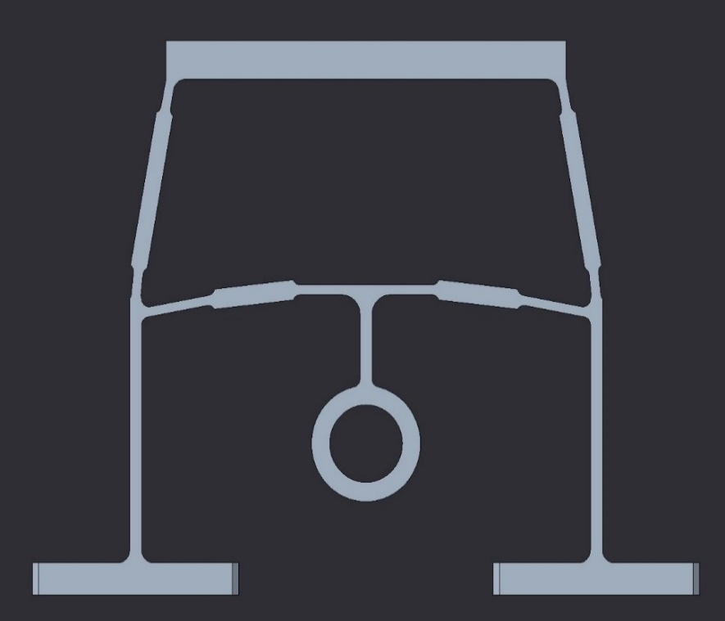
Crucial Parameters
Introduction to EHD
Parameter | Notation | Dependency level
Thin angle | A | High
Thick angle | B | High
Support angle | C | Low
Thin side thickness | D | Very high
Thick side Thickness | E | Low
Mid Thickness | F | Very low
Fillets at every sharp edge | - | Low
Middle height | G | medium
Sr. No. | Thin angle (A) | Thin Thickness (D) | Thick Angle (B) | Thick Thickness (E) | Middle Thickness (F) | Reduction ratio
1. | 100 | 0.8 | 96 | 1.6 | 0.8 | 72.51
2. | 99.5 | - | - | - | - | 74.43
3. | 99 | - | - | - | - | 80.11
4. | 100.5 | - | - | - | - | 69.25
5. | 101 | - | - | - | - | 65.58
6. | - | 0.9 | - | - | - | 88.88
7. | - | 0.7 | - | - | - | 61
8. | - | - | 95.5 | - | - | 78.20
9. | - | - | 95 | - | - | 86.44
10. | - | - | 96.5 | - | - | 67.32
11. | - | - | 97 | - | - | 62.14
12. | - | - | - | 1.7 | - | 72.75
13. | - | - | - | 1.5 | - | 72.13
14. | - | - | - | - | 0.7 | 71.11
15. | - | - | - | - | 0.9 | 74.57
C
F
E
D
Crucial Parameters
A
B
Parametric Variation
13
Under the Major Research Project Regulation
Major Research Project 2020
Major Project Review
Institute of Technology, Nirma University
Parametric Variation
Institute of Technology, Nirma University

Slide 14
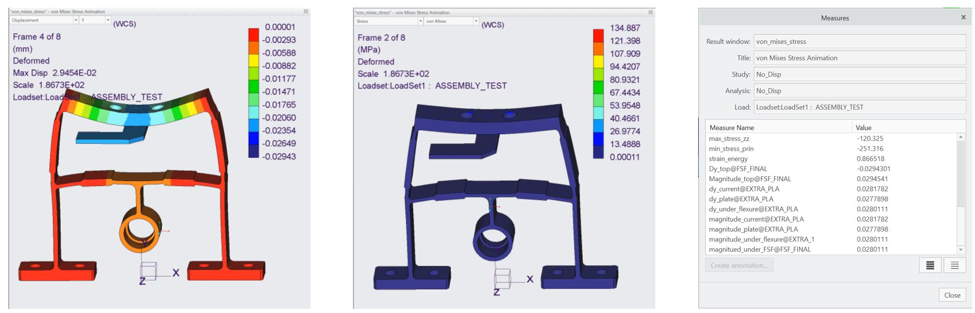
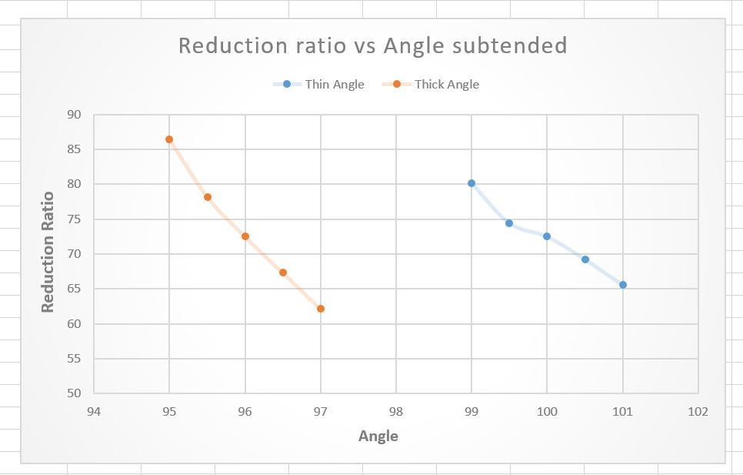
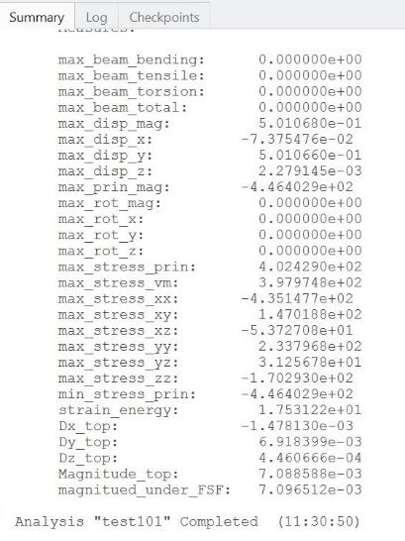
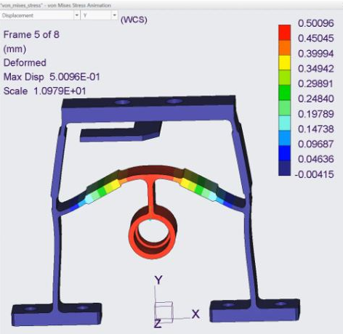
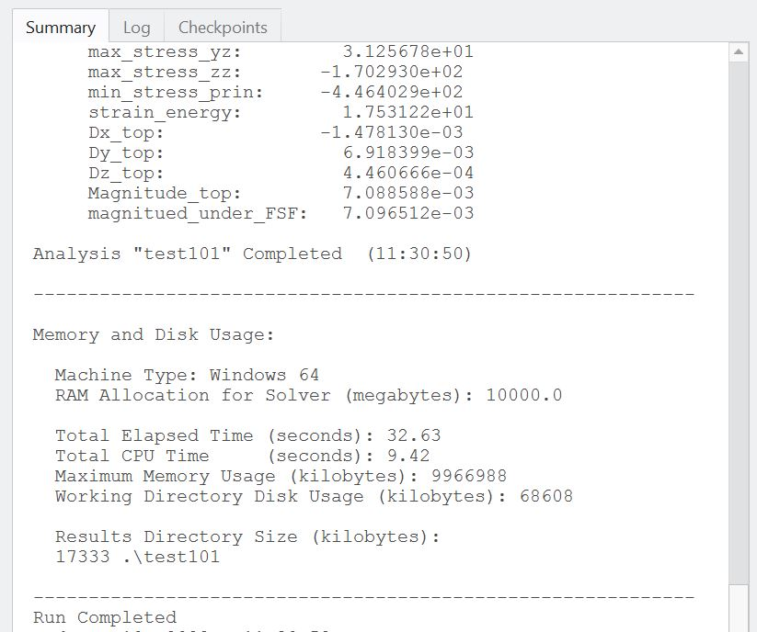
Results
Introduction to EHD
A displacement of 0.5 mm is applied to the eccentric holding. A ‘dy’ measure is placed to measure only vertical movement of the top land of ‘A’. The result shows the ideal reduction ratio as 0.5/0.0069 = 72.227.
14
Under the Major Research Project Regulation
Major Research Project 2020
Major Project Review
Institute of Technology, Nirma University
Stress Analysis
Institute of Technology, Nirma University

Slide 15
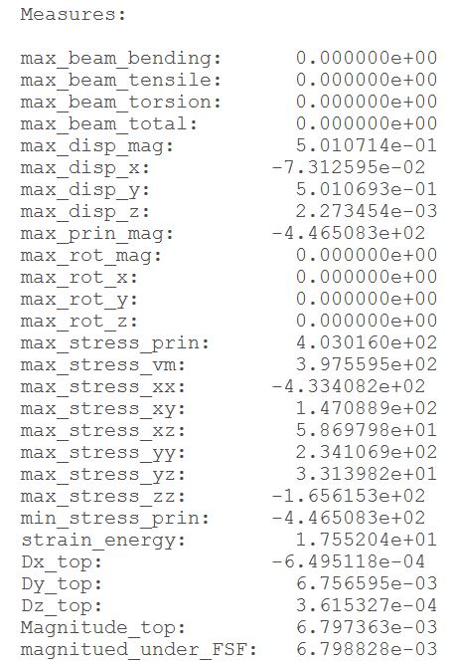
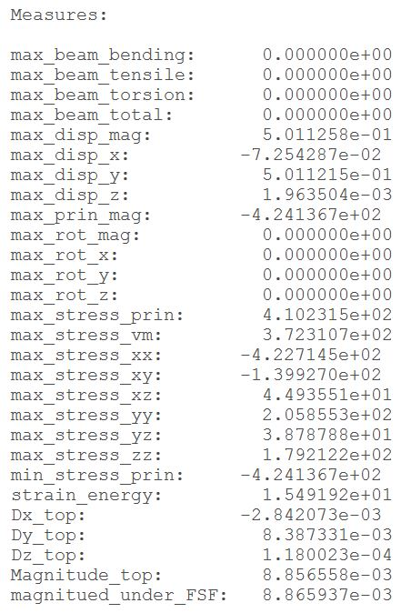
Tolerances
Introduction to EHD
Tolerances will be decided based on resolution and range, the margin being higher than the predicted value while designing. To give an example, the thick angle increased reduces the reduction ratio in turn increasing the range and resolution while vice versa happens when decreased.
So while providing tolerance for this angle it should lean towards positive side. The following table shows a summary of tolerances finalized for the critical parameters. These tolerances will then be added to the updated drawing of FSF when fabricated.
Extreme cases
Based on these tolerances, the extreme limits need to be evaluated.
Worst case – RR = 74.001
Best case – RR = 59.613
Parameter | Notation | Preferred Higher / Lower | Tolerance provided
Thin angle | A | Higher | +0.3
Thick angle | B | Higher | +0.3
Support angle | C | Equal | ±0.2
Thin thickness | D | Lower | -0.05
Thick thickness | E | Nominal | ±0.01
Middle thickness | F | Nominal | ±0.01
Middle height | G | Equal | ±0.05
Setting tolerances for Manufacturing
15
Under the Major Research Project Regulation
Major Research Project 2020
Major Project Review
Institute of Technology, Nirma University
Design
Institute of Technology, Nirma University

Slide 16
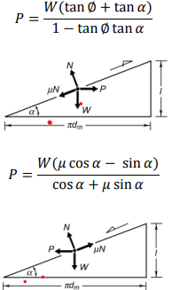
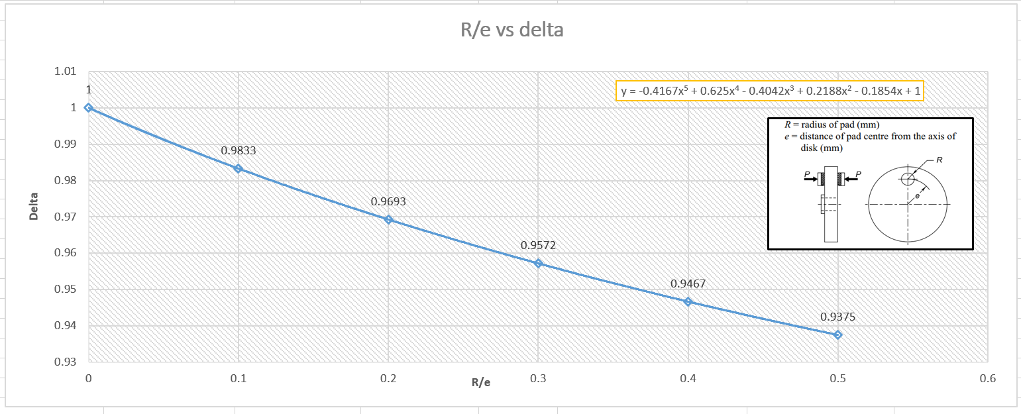
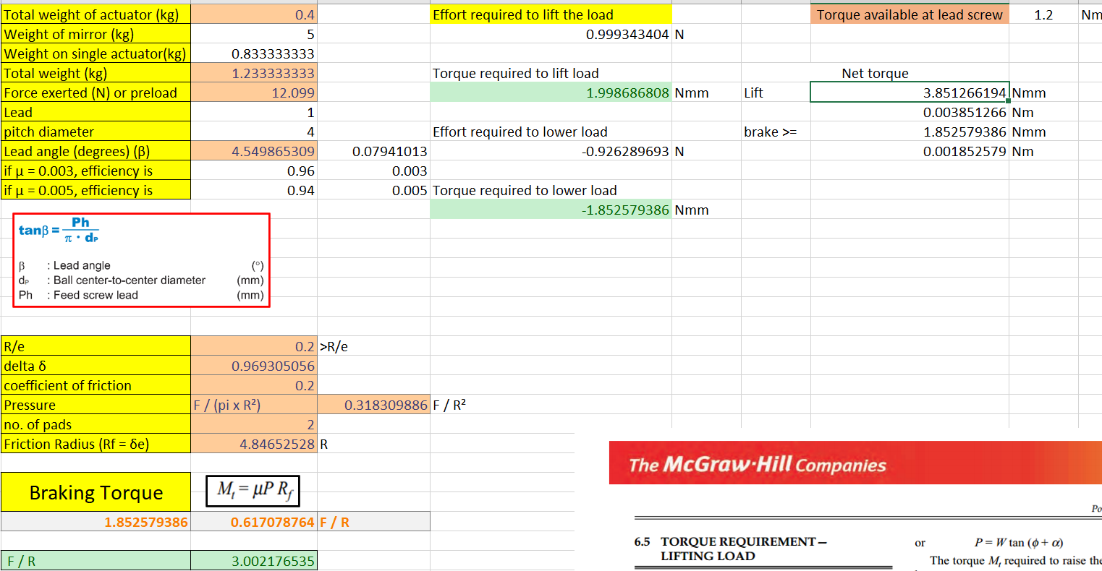
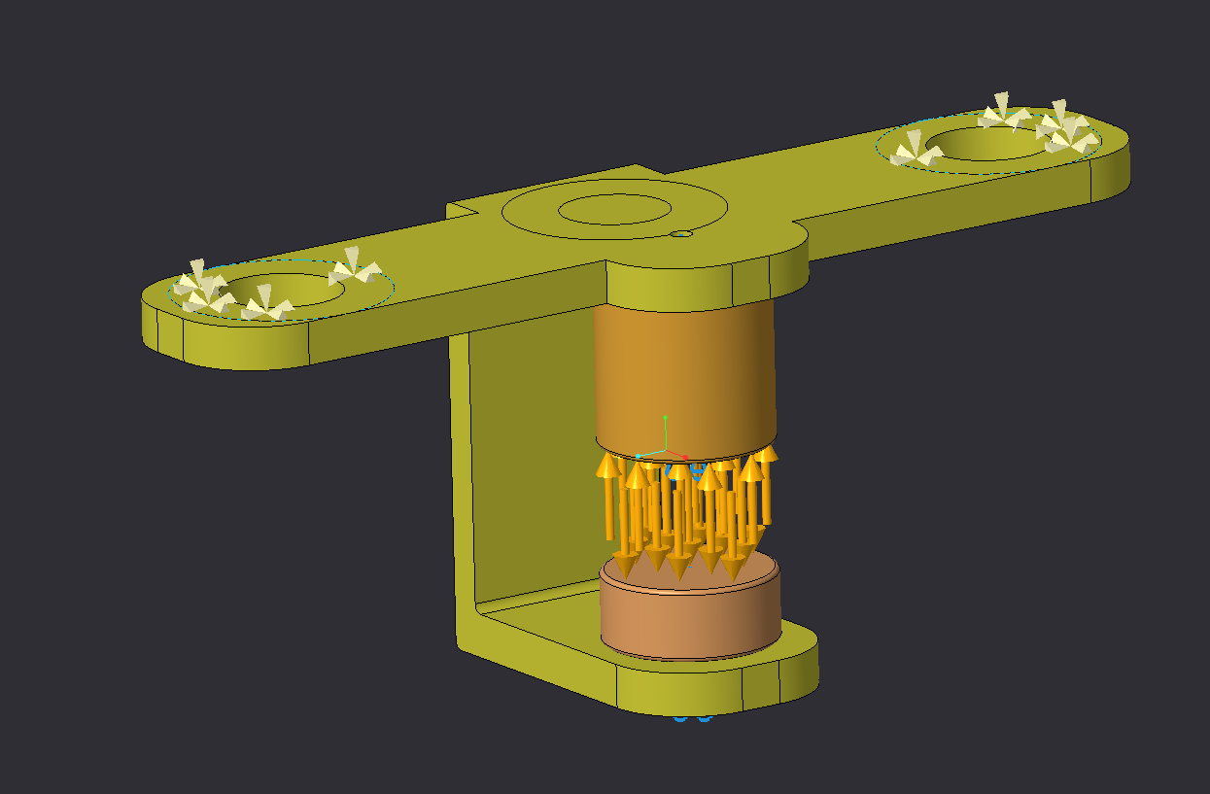
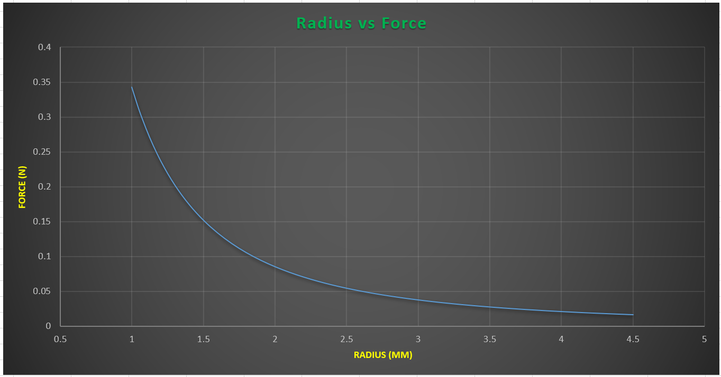
Disk Brake modelling
Introduction to EHD
A disk Brake is necessary to prevent slipping when high load is applied on the vertical ball screw but the torque required to move also increases substantially.
16
Under the Major Research Project Regulation
Major Research Project 2020
Major Project Review
Institute of Technology, Nirma University
Brake modelling
Institute of Technology, Nirma University

Slide 17
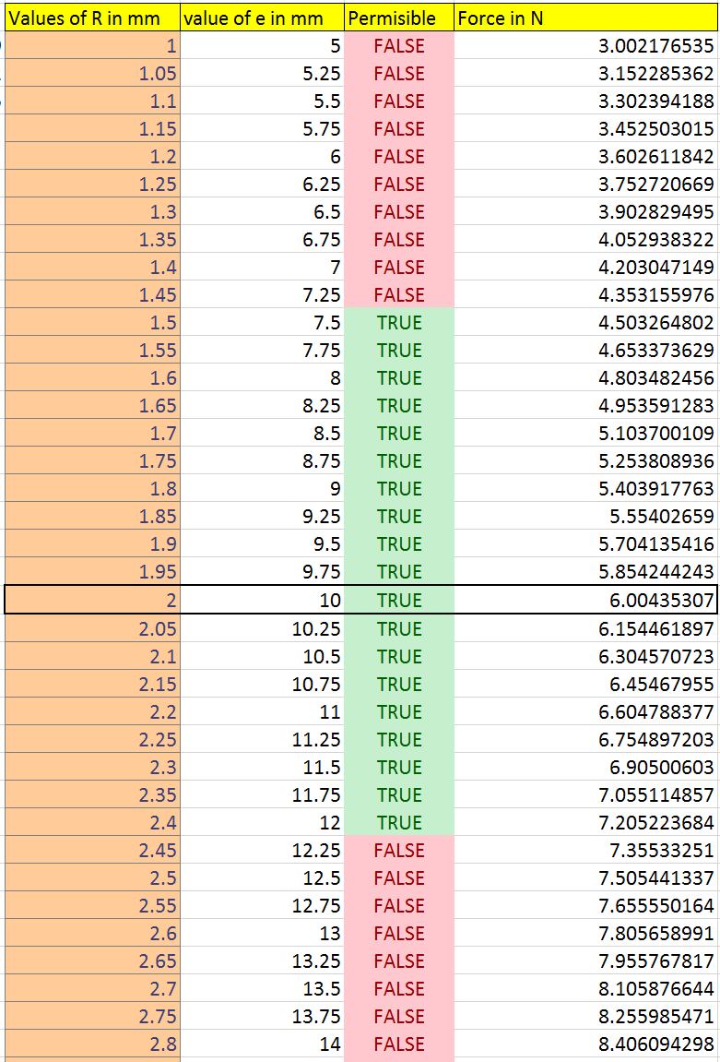
Disk Brake positioning
Introduction to EHD
A Disk Brake is necessary to prevent slipping when high load is applied on the vertical ball screw but the torque required to move also increases substantially.
17
Under the Major Research Project Regulation
Major Research Project 2020
Major Project Review
Institute of Technology, Nirma University
Disk brake placement
Institute of Technology, Nirma University

Slide 18
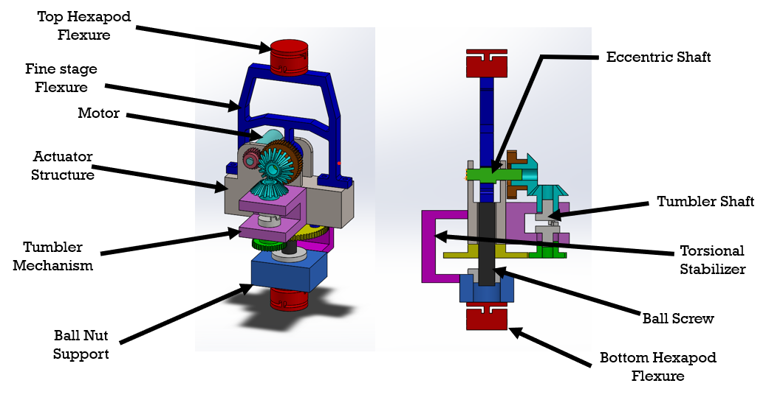
Modelling other support parts
Introduction to EHD
Spur gears
Bevel gears
Eccentric camshaft (fine motion)
Bearings
Main actuator support structure
Fine stage flexure
Coarse-Drive housing
Coarse-Drive shafts
Ball screw support
Main outer support
Shims
Torsional stabilizer
Disk brake
Hexapod flexures
18
Under the Major Research Project Regulation
Major Research Project 2020
Major Project Review
Institute of Technology, Nirma University
Support Modelling
Institute of Technology, Nirma University

Slide 19
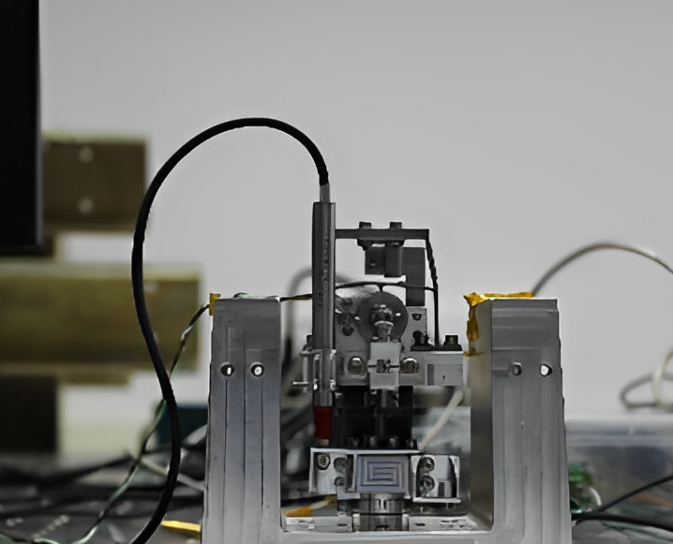
Complete Assembly
Introduction to EHD
19
Under the Major Research Project Regulation
Major Research Project 2020
Major Project Review
Institute of Technology, Nirma University
Actuator Assembly
Institute of Technology, Nirma University

Slide 20

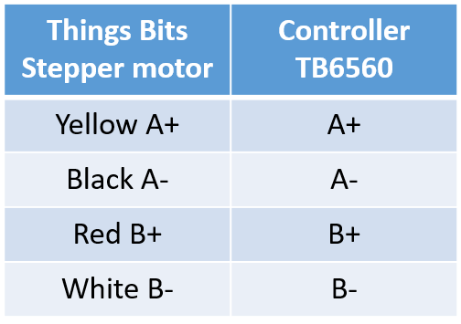
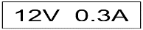

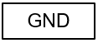
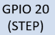
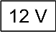


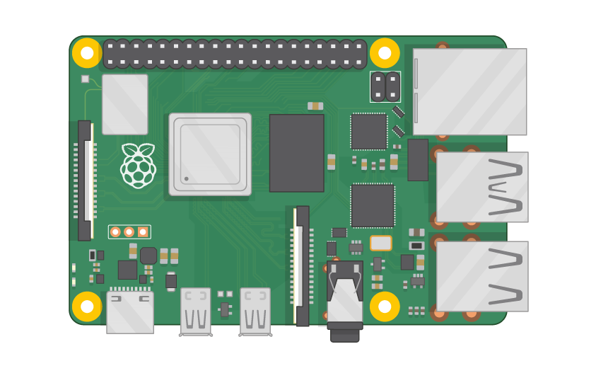
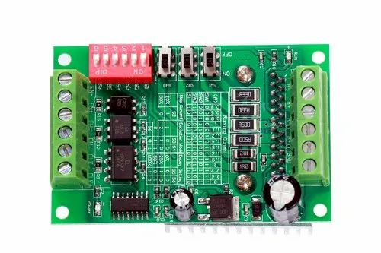
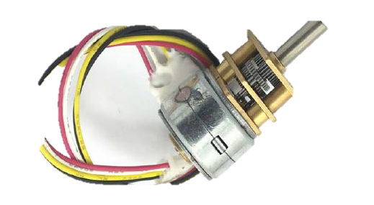



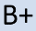



Motor No -1
Drive Electronics of single Actuator
Introduction to EHD
Computer
Controller | Raspberry Pi
CW+ | GPIO 20 STEP
CLK+ | GPIO 18 DIR
CW- CLK- | GND
Power Supply
Mouse
Motor
Key board
Driver
AC Power
Raspberry pi 4
20
Under the Major Research Project Regulation
Major Research Project 2020
Major Project Review
Institute of Technology, Nirma University
Drive Electronics of Single Actuator
Institute of Technology, Nirma University

Slide 21
Coarse motion Testing
Introduction to EHD
A vacuum compatible LVDT was brought for testing purposes checking the linear motion of the ball screw. As the resolution of the sensor is high and theoretical resolution of the ball screw is 33.33 nm, each incremental step data and the overall motion of the actuator was traced.
LVDT movement
21
Under the Major Research Project Regulation
Major Research Project 2020
Major Project Review
Institute of Technology, Nirma University
LVDT testing
Institute of Technology, Nirma University

Slide 22
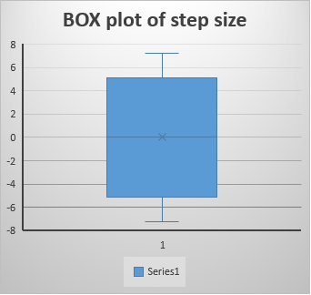
Fine motion testing
Introduction to EHD
Coarse coupler was disengaged and fine motion was tested. As per design the MRS should give a resolution of about 7 nm over a range of ~14 microns. It was found that the range and resolution were very close to the designed model, concluding that the MRS was designed seamlessly.
Avg. Resolution= 4.64 nm
Max. Resolution = 7.22 nm
Range = 13.79 microns
22
Under the Major Research Project Regulation
Major Research Project 2020
Major Project Review
Institute of Technology, Nirma University
MRS Testing
Institute of Technology, Nirma University

Slide 23
Visualization of combined motion
Introduction to EHD
23
Under the Major Research Project Regulation
Major Research Project 2020
Major Project Review
Institute of Technology, Nirma University
Combined Motion analysis
Institute of Technology, Nirma University

Slide 24
Load handling capacity
Introduction to EHD
Weight | NA | 345 grams | 460 grams | 575 grams
Graph
Range | 13.7628 Microns | 14.1818 Microns | 13.7456 Microns | 14.0867 Microns
Resolution Average | 4.70 nm | 4.78 nm | 4.67 nm | 4.74 nm
The movement of the actuator is checked along with the range and resolution while increasing the mass on the actuator by 115 grams each time capping at 575 grams.
24
Under the Major Research Project Regulation
Major Research Project 2020
Major Project Review
Institute of Technology, Nirma University
Resolution analysis
Institute of Technology, Nirma University

Slide 25
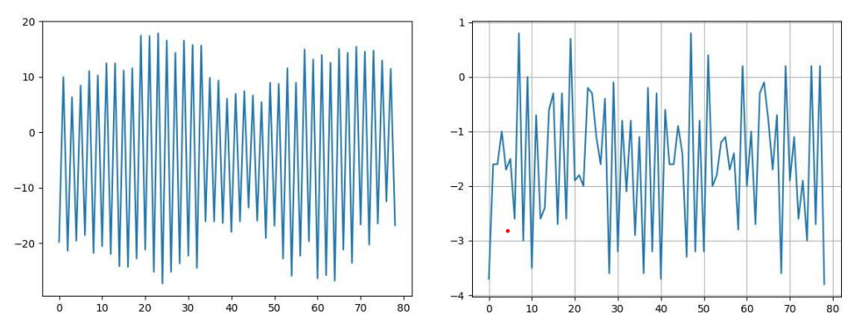
Disk Brake Attachment and remodeling
Introduction to EHD
The first model had an overlap of 100 microns from both ends. While operating and testing the brake, minor slippage could be seen when the coarse drive is engaged and disengaged.
A remodeling of the brake was necessary and another design with force distributed at both ends of the spur gear was made. This design reduced the force by reducing the overlap to 50 microns resulting in an overall decrease of 150 microns worth of overlap. After reattaching and testing, the disengagement error reduced to 3-4 microns on average.
Initial Disengagement error
Remodelled Disengagement error
25
Under the Major Research Project Regulation
Major Research Project 2020
Major Project Review
Institute of Technology, Nirma University
Reducing Disengagement error
Institute of Technology, Nirma University

Slide 26
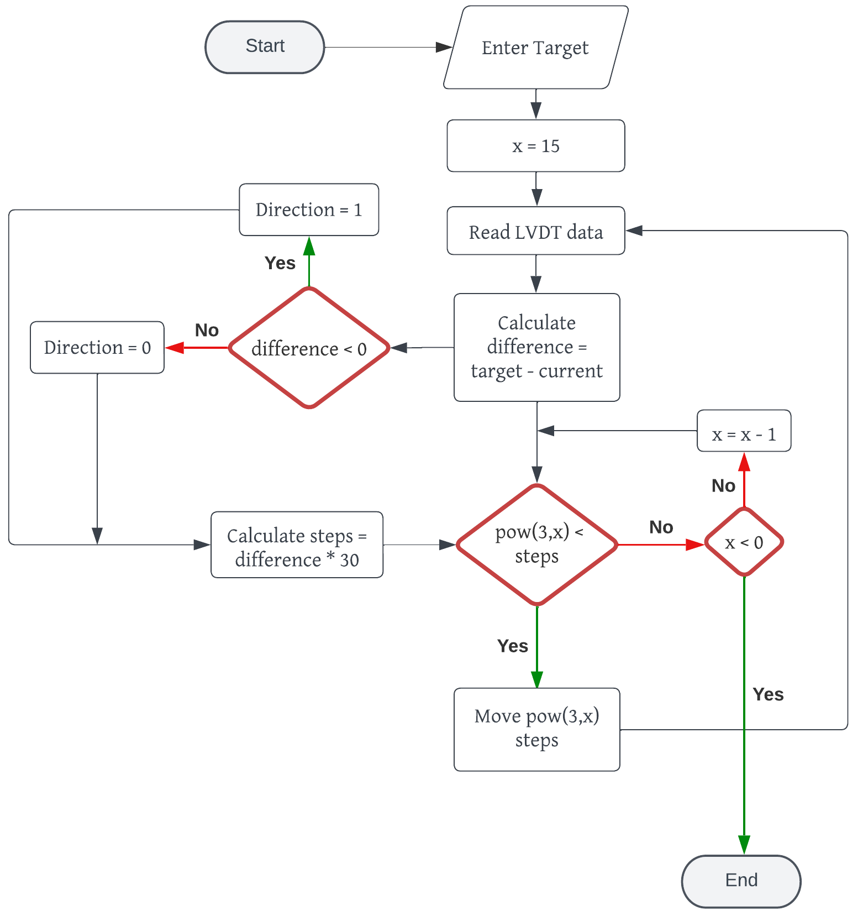
Coarse Control Algorithm
Introduction to EHD
The PID control, although best, cannot be applied in this case due to 2 separate mechanisms in action – Coarse and Fine. If the system overshoots, it cannot come back as a reversal of motion would require reengagement of the coarse drive shafts, which is time consuming.
As a result, P control is chosen. Even though it is feasible relying on P control isn’t the solution as the proportional constant can’t be removed. Hence a custom adaptive control was employed.
26
Under the Major Research Project Regulation
Major Research Project 2020
Major Project Review
Institute of Technology, Nirma University
Control Systems
Institute of Technology, Nirma University

Slide 27
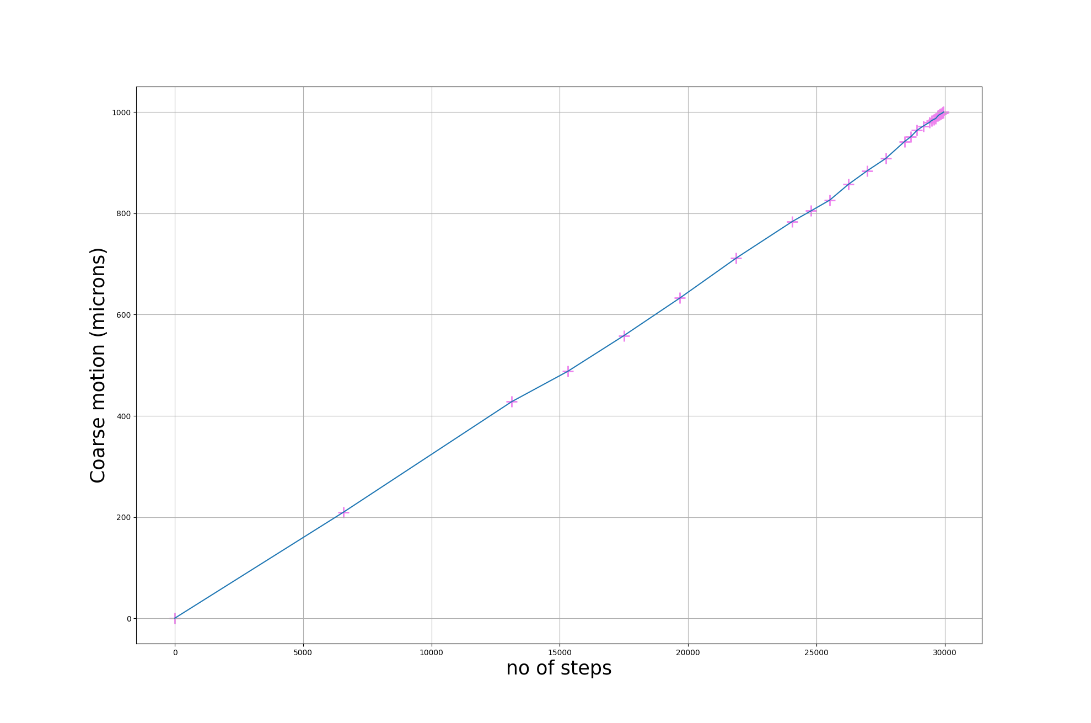
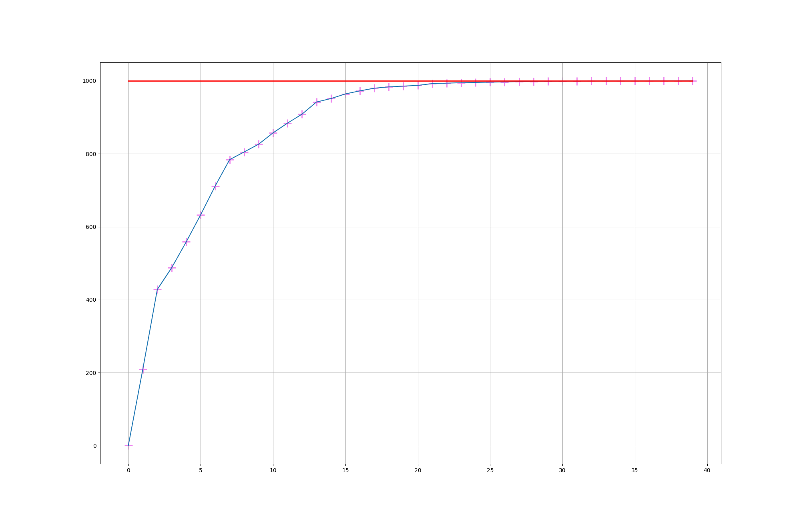
Adaptive P-control
Introduction to EHD
Linear Movement
Convergence of Adaptive P-control
27
Under the Major Research Project Regulation
Major Research Project 2020
Major Project Review
Institute of Technology, Nirma University
Control Systems
Institute of Technology, Nirma University

Slide 28
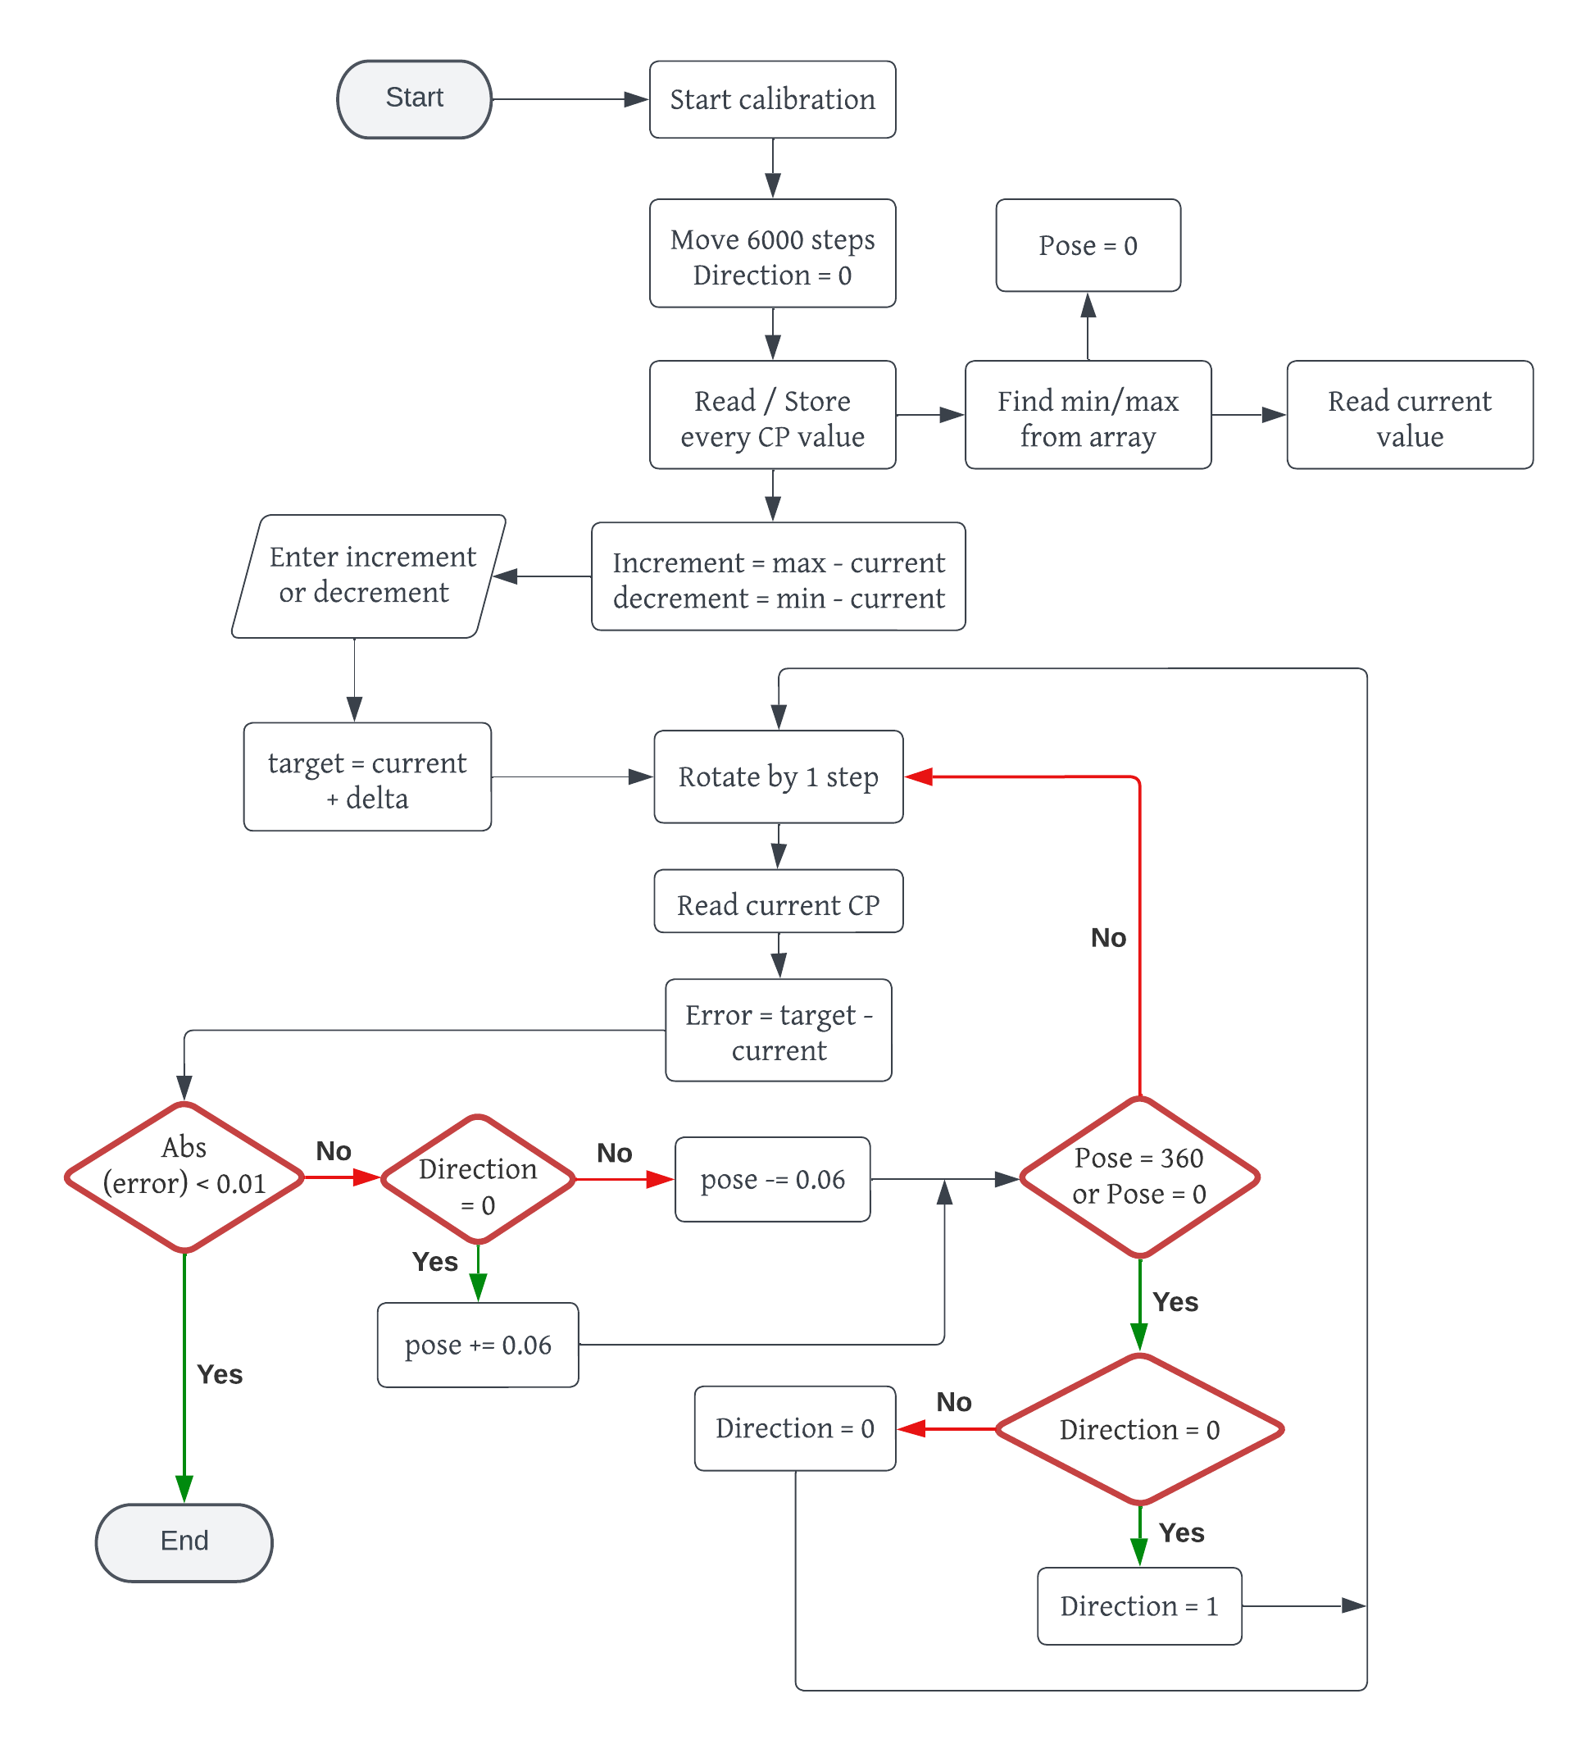
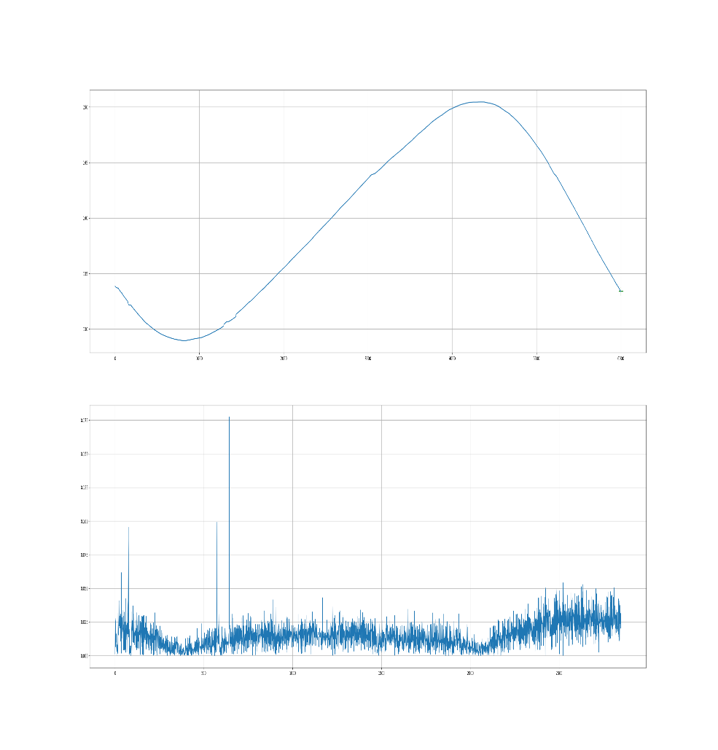
Fine control Algorithm
Introduction to EHD
Calibration
In the complete system, the calibration angle is set to 270° due to re-engagement.
28
Under the Major Research Project Regulation
Major Research Project 2020
Major Project Review
Institute of Technology, Nirma University
Control Systems - CP
Institute of Technology, Nirma University

Slide 29

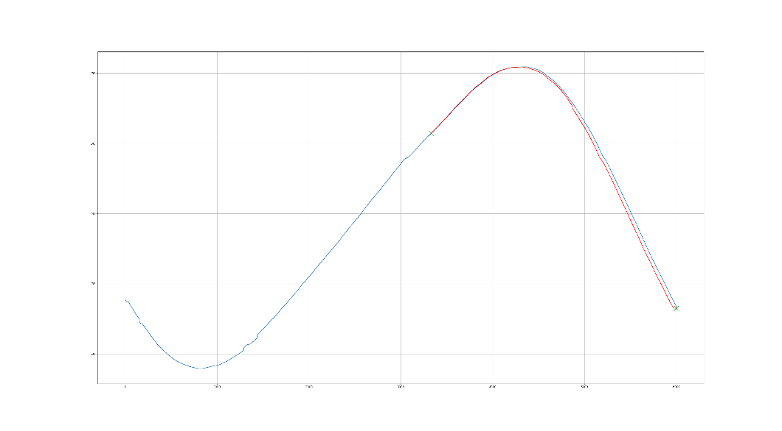


Fine control via Hunting
Introduction to EHD
Hunting of target value
29
Under the Major Research Project Regulation
Major Research Project 2020
Major Project Review
Institute of Technology, Nirma University
Control Systems - CP
Institute of Technology, Nirma University

Slide 30

Combined control algorithm
Introduction to EHD
30
Under the Major Research Project Regulation
Major Research Project 2020
Major Project Review
Institute of Technology, Nirma University
Control Systems - CP
Institute of Technology, Nirma University

Slide 31


Combined control verification and example
Introduction to EHD
Start
Pseudo - code
Mathematical verification
Example
Current_LVDT = 70.0
Current_CP = 245.678
Enter delta, $∆$
(increment or decrement)
of actuator
Math of Combined loop with variables
Current LVDT = L1
Current CP = C1
Delta = D1 = L_move + CP_move
Delta = LVDT movement + CP movement = L_move + CP_move
Target = L1 + D1 = L1 + L_move + CP_move
LVDT goes to
Goto = L1 + L_move
Calibrate CP
New CP = C2
New LVDT = L2
LVDT error while calibrating:
LVDT_cal_error =(L1 + L_move) – L2
CP error = C1 – C2
LVDT error = Target – L2
= Target – L2
= (L1 + L_move + CP_move) – L2
= CP_move + ((L1 + L_move) – L2)
= CP_move + LVDT_cal_error
Combined error = CP_error + LVDT_error
Goto Combined_error
$∆$ = 50.123
Target = current_LVDT + delta
Target = 70 + 50.123 = 120.123
Go to target
rounded to 0 decimals
Go to 120
Reach target
Reach target
Calibrate CP to find current pose and extremities
Calibrate_CP
Current_CP = 251.323
Upper limit = 253.443
Lower_limit = 239.222
Get current LVDT and CP pose
Current_LVDT = 119.1
Current_CP = 251.323
Compute individual error
CP error = 245.678 – 251.323 = -5.645
LVDT error = 120.123 - 119.1 = 1.023
Compute total error
Move CP by total error
Total error =
-5.645 + 1.023 = -4.622
Yes
Target reached?
Target reached
End
No
31
Under the Major Research Project Regulation
Major Research Project 2020
Major Project Review
Institute of Technology, Nirma University
Control Systems
Institute of Technology, Nirma University

Slide 32


Dash app initial stages
Introduction to EHD
A GUI is needed to control the entire system and monitor the movement of LVDT and capacitance probe real-time. A server on python is being built using Dash framework for visualization and to give commands to Rpi.
32
Under the Major Research Project Regulation
Major Research Project 2020
Major Project Review
Institute of Technology, Nirma University
Server creation
Institute of Technology, Nirma University

Slide 33

Addressing discrepancies
Introduction to EHD
it was soon discovered that the internal movement of the actuator after the closed loop code did not match up with the external sensor that was mounted to the table rigidly.
The orange line shows the measurements from the sensor mounted with the table and the blue line shows the internally measured movement. The second graph shows the difference of both movement at every step. We can see the difference is significant and as high as 4 microns.
Mismatch observed b/w internal and external movement
33
Under the Major Research Project Regulation
Major Research Project 2020
Major Project Review
Institute of Technology, Nirma University
Error Handling
Institute of Technology, Nirma University

Slide 34



External repeatability testing
Introduction to EHD
Errors:
Vertical offset
Horizontal offset
Vertical offset removed
by Reducing 12 RPM to 0.9 & 0.3 RPM
Horizontal offset removed by correcting motor steps. (2000 -> 1980 for one rotation of motor)
34
Under the Major Research Project Regulation
Major Research Project 2020
Major Project Review
Institute of Technology, Nirma University
Error Handling
Institute of Technology, Nirma University

Slide 35



Mass Experimentation
Introduction to EHD
The tests included further decrease of rpm to as slow as 0.3 rpm which resulted in the duration of tests capping at 3-4 hours. At the same time, iterations were increased to 20, 50 and 70. When the iterations reached 70, the vertical shift could be seen again, albeit small. Soon, it was concluded that the rpm and motor steps stopped having an effect in improving the repeatability.
Tests | Iterations | RPM | Iterative offsets (nm) | Cumulative Offsets (nm)
1 | 10 | 12 | 160 | 200
2 | 10 | 15 | 200 | 563
3 | 10 | 0.3 | 50 | 120
4 | 6 | 0.9 | 200 | 200
5 | 50 | 3 | 290 | 2500
6 | 20 | 3 | 220 | 460
7 | 10 | 0.9 | 60 | 135
8 | 70 | 3 | 310 | 2700
35
Under the Major Research Project Regulation
Major Research Project 2020
Major Project Review
Institute of Technology, Nirma University
Error Reduction
Institute of Technology, Nirma University

Slide 36


Stability check
Introduction to EHD
The sensors were kept undisturbed for 30 mins and the frequency of measurement reduced for precise measurements. It was observed that the CP errors ranged 400, 700 and 1400 nm in 3 different sensors over 30 minutes of measuring.
Static CP error
Another test setup made up of invar was then utilized it has an extremely low coefficient of thermal expansion.
It was found that the invar setup reduced the error by 10 times giving the error values of 70, 30 and 60 nm
Static CP error: Invar
36
Under the Major Research Project Regulation
Major Research Project 2020
Major Project Review
Institute of Technology, Nirma University
Error Identification
Institute of Technology, Nirma University

Slide 37



Relative Repeatability
Introduction to EHD
Iterative: ~9 nm
Total:~100 nm
Iterative:~ 6nm
Total:~ 60nm
The tests verified the fact that the sensors measurements are shifting over time and the cumulative errors cap at 60-70 nm with each iterative error being around 5-6 nms.
Iterative: ~4 nm
Total: ~50 nm
37
Under the Major Research Project Regulation
Major Research Project 2020
Major Project Review
Institute of Technology, Nirma University
Error Reduction
Institute of Technology, Nirma University

Slide 38

Multi-Actuator integration and testing
Introduction to EHD
38
Under the Major Research Project Regulation
Major Research Project 2020
Major Project Review
Institute of Technology, Nirma University
6 Actuator Assembly setup
Institute of Technology, Nirma University

Slide 39
QC and mating parts
Introduction to EHD
Pre-made parts such as bearing and ball screws had to mate properly with their mating parts to form an interference fit. While designing, the tolerances kept for critical mating parts were such that they ensured interference fit even in the worst case. For all holes, pin gauges were used to get precise dimensions.
Careful assembly by the use of a lathe and chuck to hold the parts was done. Some of the critical mating parts are listed below, due to peculiar assemblies of these parts a correct order of assembly was also needed to be set in place.
Eccentric shaft and bearings
Bearings and actuator support structure
MRS and eccentric shaft
Coarse drive shafts and bearings
Coarse drive shafts with bearings and its housing
Ballscrew and bearings
Ballscrew with bearings and Actuator support structure
MRS with eccentric shaft and ballscrew with actuator structure
39
Under the Major Research Project Regulation
Major Research Project 2020
Major Project Review
Institute of Technology, Nirma University
Quality Check
Institute of Technology, Nirma University

Slide 40


Integrated Drive Electronics
Introduction to EHD
Block Diagram for Central Controller Unit
Drive Electronics Setup
40
Under the Major Research Project Regulation
Major Research Project 2020
Major Project Review
Institute of Technology, Nirma University
6 Actuator Drive Electronics setup
Institute of Technology, Nirma University

Slide 41



Characterizing range and resolution of 6 Actuators
Introduction to EHD
Actuator 1
Range = 14.783 µm
Avg. Resolution = 4.927 nm
Actuator 2
Range = 22.675 µm
Avg. Resolution = 7.558 nm
Actuator 3
Range = 21.471 µm
Avg. Resolution = 7.157 nm
41
6 Actuator testing and optimizing
Under the Major Research Project Regulation
Major Project Review
Institute of Technology, Nirma University
Institute of Technology, Nirma University

Slide 42



Characterizing range and resolution of 6 Actuators
Introduction to EHD
Actuator 4
Range = 26.416 µm
Avg. Resolution = 8.805 nm
Actuator 5
Range = 21.932 µm
Avg. Resolution = 7.310 nm
Actuator 6
Range = 16.096 µm
Avg. Resolution = 5.3656 nm
42
6 Actuator testing and optimizing
Under the Major Research Project Regulation
Major Project Review
Institute of Technology, Nirma University
Institute of Technology, Nirma University

Slide 43


Weight handling of 6 Actuators
Introduction to EHD
The mirror to be mounted on the 6 actuators weight around 3 kilos.
Assuming each actuator shares equal weight at all times, they need to hold their current position without any slippage.
Any slippage causes loss of steps and nonmetric movement.
The actuators were first tested without any friction brake to check innate slippage and later disk brake will be applied
Actuators | Slippage
A1 | Yes
A2 | No
A3 | Minor
A4 | Yes
A5 | No
A6 | Minor
Dummy model of actuator
43
Multi-Actuator Load handling
Under the Major Research Project Regulation
Major Project Review
Institute of Technology, Nirma University
Institute of Technology, Nirma University

Slide 44

Bipod Integration and Testing
Introduction to EHD
44
Bipod Assembly
Under the Major Research Project Regulation
Major Project Review
Institute of Technology, Nirma University
Institute of Technology, Nirma University

Slide 45



Bipod z motion Integration and Testing
Introduction to EHD
Bipod z-motion (Disengaged)
Bipod Motion Disturbance
$$f_{1}\left(t\right)= A\sin{(ωt)}$$
$$f_{2}\left(t\right)= A\sin{(ωt+δ)}$$
$$g\left(t\right)=f_{1}\left(t\right)−f_{2}\left(t\right)=A\sin{(ωt)}−A\sin{(ωt+δ)}$$
$$g\left(t\right)=2×A×sin\left(δ/2\right)×\cos{(ωt+δ/2)}$$
Phase Shift
Amplitude
Frequency
45
Bipod Movement
Under the Major Research Project Regulation
Major Project Review
Institute of Technology, Nirma University
Institute of Technology, Nirma University

Slide 46


Correlation of legs of a Bipod
Introduction to EHD
Bipod CAD model
Correlation for Reduction Ratio
From the continuous reversal of direction of motor of the actuator to keep the motion constrained to MRS, the difference of their movement results in a sinusoidal wave.
It can be concluded that the sine wave for reduction ratio/difference is phase shifted by a perfect 90 degrees. From the graph we can see the reduction ratio stays in a range of 0.35 to 0.4.
46
Correlation
Under the Major Research Project Regulation
Major Project Review
Institute of Technology, Nirma University
Institute of Technology, Nirma University

Slide 47

Control Mechanism for Bipod Control: Method 1
Introduction to EHD
47
Control Systems
Under the Major Research Project Regulation
Major Project Review
Institute of Technology, Nirma University
Institute of Technology, Nirma University

Slide 48
Drawbacks of method 1
Introduction to EHD
We can see that this method takes a lot of time along with high feedback count which the project aims to be as small as possible.
Another downside of this method is the stresses that are generated when pushing one of the actuators while keeping the other stationary. If the actuators are moved to opposite extremities, the stresses induced, border the limits.
To overcome the drawbacks, another algorithm was developed which turned out to be more efficient.
49
Control Systems
Under the Major Research Project Regulation
Major Project Review
Institute of Technology, Nirma University
Institute of Technology, Nirma University

Slide 49

Control Mechanism for Bipod Control: Method 2
Introduction to EHD
50
Control Systems
Under the Major Research Project Regulation
Major Project Review
Institute of Technology, Nirma University
Institute of Technology, Nirma University

Slide 50





Stewart Platform (Hexapod Assembly)
Introduction to EHD
A Stewart platform consists of a fixed base and a movable platform connected by a series of six extendable and adjustable legs or kinematic chains. Each leg typically consists of a combination of linear actuators and universal joints that allow for both translational and rotational motion. The translational movement is provided by the Actuators connected in the Bipod assembly and the rotational stiffness can be given by the top and bottom flexures of the Actuators along with the connecting pad.
Simulation model
Simulation of a hexapod system
Hexapod dummy CAD model
52
Simulation
Under the Major Research Project Regulation
Major Project Review
Institute of Technology, Nirma University
Institute of Technology, Nirma University

Slide 51


Assembly of a Hexapod
Introduction to EHD
Hexapod final CAD model
53
Assembly and modelling
Under the Major Research Project Regulation
Major Project Review
Institute of Technology, Nirma University
Institute of Technology, Nirma University

Slide 52



Inverse kinematics of Stewart platform
Introduction to EHD
Inverse kinematics of a hexapod refers to the process of determining the required actuator positions to achieve a desired position and orientation of the hexapod's platform (mirror in our case). In other words, it involves finding the link lengths that will result in a specific position and orientation of the mirror.
Where α, β and γ denote the rotation of points about the x, y and z axis respectively. Say there are 6 points on the top of the mirror plate in the initial position - $p_{1}$, $p_{2}$, $p_{3}$, $p_{4}$, $p_{5}$ and $p_{6}$. The points are then transformed and rotated as per the rotation matrix calculated. The new points are denoted by $p_{1}^{′}$, $p_{2}^{′}$, $p_{3}^{′}$, $p_{4}^{′}$, $p_{5}^{′}$ and $p_{6}^{′}$. The vector difference of these 2 points give us the increase or decrease in the actuator lengths of the Hexapod legs. The magnitude of the vector then gives the exact distance to move to achieve the desired position. This length is fed to the Actuators and the Hexapod assembly is moved.
$$R_{x}(α)=\left[\begin{matrix}1 & 0 & 0 \\ 0 & \cos{α} & −\sin{α} \\ 0 & \sin{α} & \cos{α}\end{matrix}\right]$$ | $$R_{y}(β)=\left[\begin{matrix}\cos{β} & 0 & \sin{β} \\ 0 & 1 & 0 \\ −\sin{β} & 0 & \cos{β}\end{matrix}\right]$$ | $$R_{z}(γ)=\left[\begin{matrix}\cos{γ} & −\sin{γ} & 0 \\ \sin{γ} & \cos{γ} & 0 \\ 0 & 0 & 1\end{matrix}\right]$$
$$R_{x}(α)R_{y}(β)R_{z}(γ)=\left[\begin{matrix}\cos{β}\cos{γ} & −\cos{β}\sin{γ} & \sin{β} \\ \cos{α}\cos{γ}+\sin{α}\sin{β}\cos{γ} & \cos{β}\cos{γ}− \sin{α}\sin{β}\sin{γ} & −\sin{α}\cos{β} \\ \sin{α}\sin{γ}−\cos{α}\sin{β}\cos{γ} & \sin{α}\cos{γ}−\cos{α}\sin{β}\sin{γ} & \cos{α}\cos{β}\end{matrix}\right]$$
$$p_{1}=\left[\begin{matrix}x_{1} \\ y_{1} \\ z_{1}\end{matrix}\right]$$ | $$p_{2}=\left[\begin{matrix}x_{2} \\ y_{2} \\ z_{2}\end{matrix}\right]$$ | $$p_{3}=\left[\begin{matrix}x_{3} \\ y_{3} \\ z_{3}\end{matrix}\right]$$ | $$p_{4}=\left[\begin{matrix}x_{4} \\ y_{4} \\ z_{4}\end{matrix}\right]$$ | $$p_{5}=\left[\begin{matrix}x_{5} \\ y_{5} \\ z_{5}\end{matrix}\right]$$ | $$p_{6}=\left[\begin{matrix}x_{6} \\ y_{6} \\ z_{6}\end{matrix}\right]$$
$$p_{1}^{′}=p_{1}R=\left[\begin{matrix}x_{1}^{′} \\ y_{1}^{′} \\ z_{1}^{′}\end{matrix}\right]$$ | $$p_{2}^{′}=p_{2}R=\left[\begin{matrix}x_{2}^{′} \\ y_{2}^{′} \\ z_{2}^{′}\end{matrix}\right]$$ | $$p_{3}^{′}=p_{3}R=\left[\begin{matrix}x_{3}^{′} \\ y_{3}^{′} \\ z_{3}^{′}\end{matrix}\right]$$ | $$p_{4}^{′}=p_{4}R=\left[\begin{matrix}x_{4}^{′} \\ y_{4}^{′} \\ z_{4}^{′}\end{matrix}\right]$$ | $$p_{5}^{′}=p_{5}R=\left[\begin{matrix}x_{5}^{′} \\ y_{5}^{′} \\ z_{5}^{′}\end{matrix}\right]$$ | $$p_{6}^{′}=p_{6}R=\left[\begin{matrix}x_{6}^{′} \\ y_{6}^{′} \\ z_{6}^{′}\end{matrix}\right]$$
$$L_{1} = p_{1}^{′}−p_{1}$$ | $$L_{2} = p_{2}^{′}−p_{2}$$ | $$L_{3} = p_{3}^{′}−p_{3}$$ | $$L_{4} = p_{4}^{′}−p_{4}$$ | $$L_{5} = p_{5}^{′}−p_{5}$$ | $$L_{6} = p_{6}^{′}−p_{6}$$
54
Parallel manipulator
Under the Major Research Project Regulation
Major Project Review
Institute of Technology, Nirma University
Institute of Technology, Nirma University

Slide 53
Z-control, Rx and Ry control of hexapod
Introduction to EHD
The z control of the platform involves uniform movement of the mirror plate. It is easy to imagine that the parallel movement of all bipods at the same time will not work due to the sinusoidal wave generated as a result of difference of their MRS positions. A three-point plane mechanism was used to determine the position and orientation of the mirror plate. 3 sensors placed at the center of the 3 bipods dictate the translational motion
The test mirror plate has a very high surface finish resulting in a flat surface. Using the 3 measured values from the sensors, one can form a plane and find the inclinations about the xy, yz and zx planes resulting in calculation of three movements: z, Rx and Ry. The in-plane movements can be found by placing sensors beside the mirror plate checking the translation in x and y directions.
The algorithm for Z control is similar to the bipod control. The values are calculated for the 3 sensors and coarse and fine motions are operated repeatedly via hunting. It follows the notion that as the 3 points form a plane, and the mirror plate is also extremely flat, the 2 should overlap and coincide perfectly verifying the orientation of the mirror plate
These 2 rotations can be easily using the same setup from the previous test. Rotation matrix calculated in the previous topics can rotate the current measurements by the desired angles and give the new values to be read by the sensors to achieve the desired rotation. One thing to note here is that the rotation matrix also displaces the x and y coordinates of the sensors which in reality aren’t displaced. To tackle this problem equation of plane needs to be formed using the transformed values. Inputting the values of the sensor’s location in the xy plane gives the z value of the target position that the sensors need to read for desired orientation. Using the control algorithm of z control is possible to control these as well.
55
Control Systems
Under the Major Research Project Regulation
Major Project Review
Institute of Technology, Nirma University
Institute of Technology, Nirma University

Slide 54
Summary and conclusion
Introduction to EHD
The design and Development of a compact Actuator capable of dual movement was completed along with the control and assembly of bipod and hexapod systems. Parametric study and stress analysis of the Motion Reduction Flexure was performed calculating optimal reduction ratio for the desired range and resolution. Supporting parts were modelled and manufactured leading to the assembly of several actuators. Thorough QC of all the parts was done before starting the assembly due to sensitivity of the parts involved.
Control mechanism for the coarse and fine control of the Actuators was developed in Raspberry Pi using Thonny. Combined control for a given change of the actuator length was also developed. During the process, errors and inconsistencies between the internal and external sensors that affected the combined control of the actuator were reduced and an attempt to characterize the actuator was made. Due to mechanical errors and motor limitations, repeatability under 10 nm could not be achieved. The control method of the hexapod and bipod system was then changed to a active feedback control system.
The MRS designed for each actuator gave varied range and resolutions capping at 26 microns. The pairs for bipod assemblies were formed based on the closest values to minimize stresses and deviations when operating in closed loop. Control mechanism for the Bipod in 2 degrees of freedom was developed and successfully carried out reaching an angular resolution of 1 arc second and a translational resolution of 10 nm. The project then proceeded to assemble the complete hexapod and 3 degrees of freedom were controlled in the end.
56
Summary
Under the Major Research Project Regulation
Major Project Review
Institute of Technology, Nirma University
Institute of Technology, Nirma University

Slide 55
Future work
Introduction to EHD
The remaining 3 degrees of freedom needs to be controlled to achieve a complete hexapod mechanism. Although the Rz movement isn’t necessary, it is still an objective of the project. The translational x and y movements can be controlled by placing sensors along the x and y axis.
Although this method would still give the same results as when using inverse kinematics, a perfect inverse kinematics model for the hexapod platform is still the ideal method. The upcoming stages of the project will focus on controlling the remaining degrees of freedom and perfectly characterizing the actuator enabling it to operate via the IK solutions.
57
Handover
Under the Major Research Project Regulation
Major Project Review
Institute of Technology, Nirma University
Institute of Technology, Nirma University

Slide 56
Thank You
for your Attention..

